Slide 1
FOOD FORESIGHT COVID-19
Impact on the agri-food sector in 12 RIS countries from Central and Eastern Europe
Project stages:
Diagnosis and Horizon Scanning
COVID-19 Impact Mapping
Scenarios drawing
Highlighting consequences
Policy and investment implications

Slide 2
Stituation of Slovenian Agrifood sector
Key macro vulnerabilities
Ageing population
Decelerating economic growth.
Exposure to uncertainty at global level and decline in international trade.
Faltering investment in machinery and equipment.
Imports outpacing exports.

Slide 3
Four scenarios
CONSUMERS BACK TO OLD WAYS OF CONSUMPTION and PURCHASING
FULL RECOVERY PATHWAY
NEW RULEBOOK PATHWAY
ECONOMY RECOVERED WITH LIMITED CONTAINMENT MEASURES
ECONOMY DECLINING WITH NEW CONTAINMENT MEASURES
NEW CONSUMER PATHWAY
DISTORTION AND DISRUPTION PATHWAY
CONSUMERS LEARNING NEW HABITS

Slide 5
Key Opportunities for a Sustainable Recovery
Farmers and input providers
Opportunity | Source
Potential new consumer base | More individuals seeking local products
Innovations in the production process towards better resource efficiency and lower environmental impact | Changing demand and social preferences requiring alterations to the production process
More direct contact with consumers and higher margins | Shortened distance between farmers and consumers as a result of changing consumer preferences
Economies of scale through increased national and regional cooperation | Disruption of larger international supply chains but continued investments in transport infrastructure in CEE

Slide 6
Key Opportunities for a Sustainable Recovery
Food processing, storage, and transport
Opportunity | Source
Opportunities for local suppliers to showcase their own products | Growing consumer interest in local goods as well as products will lower environmental footprint
Opportunity to “green” the food production process | Changing demand requiring alterations to the production process
New and effective transport and storage solutions | Transport disruptions
Need for higher self-sufficiency within the country or region | Trade and supply chain disruptions

Slide 7
Key Opportunities for a Sustainable Recovery
Retailers, restaurants, and consumers
Opportunity | Source
More informed consumer choices and new fields of competition | Growing tendency to prepare food at home and sustainability-awareness
Higher interest in local food retailers and markets and resulting positive effect on margins | Growing consumer interest in local products
Growing interest in specialized stores and resulting positive effect on margins | More demanding consumers due to continued socio-economic development or health & dietary needs
Digitalization – rise of online ordering and home delivery of food | Necessity or desire to remain home

Slide 8
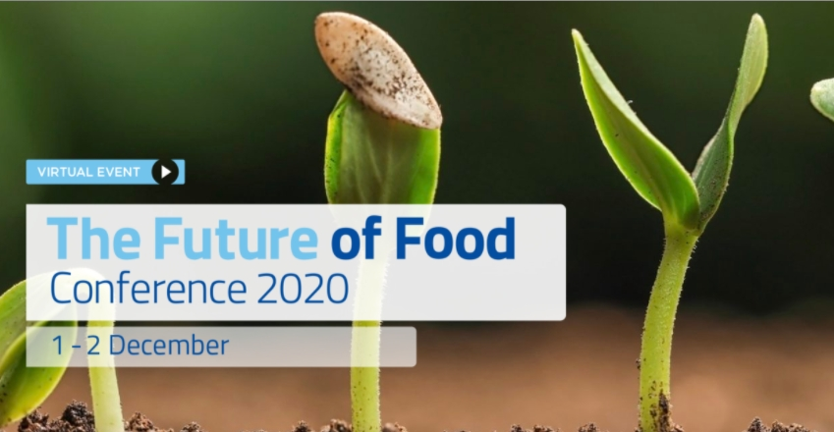
Follow the discussion!
Official Launch of the report online: Agrifood sector in Southern and Eastern Europe: Future-proof or future-ready? (28th October)
Session on the impact of COVID19 on the agrifood sector during Future of Food conference (1-2 December)
Download the report!
http://eitfood.eu/foodforesight

